Slide 1

MIST 6360 Introduction to Business Analytics
Hugh J. Watson
Professor of MIS

Slide 2

Hugh J. Watson
Professor of MIS
Purdue and FSU graduate
Spent career at UGA
Specializes in decision support and analytics
Coordinates the MIS Advisory Board
Notes:
Hugh J. Watson is a Professor of MIS in the Terry College of Business at the University of Georgia. Hugh is a leading scholar and authority on business intelligence and analytics, having authored 24 books and over 200 scholarly journal articles. Hugh helped develop the conceptual foundation for decision support systems in the 1970’s, researched the development and implementation of executive information systems in the 1980’s, and for the past twenty years has specialized in data warehousing, BI, and analytics. Dr. Watson has consulted with numerous global organizations, including the World Bank, Intel, IBM, Conoco, and Glaxo, and conducted hundreds of executive development programs. Hugh is a Fellow of the Association for Information Systems and The Data Warehousing Institute and is the Senior Editor of the Business Intelligence Journal. He is also the founder and a Fellow of the Teradata University Network, a free portal for faculty and students who want to learn about data warehousing, BI/DSS, analytics, and database. For 20 years, Hugh was the consulting editor for John Wiley & Sons’ MIS series.

Slide 3





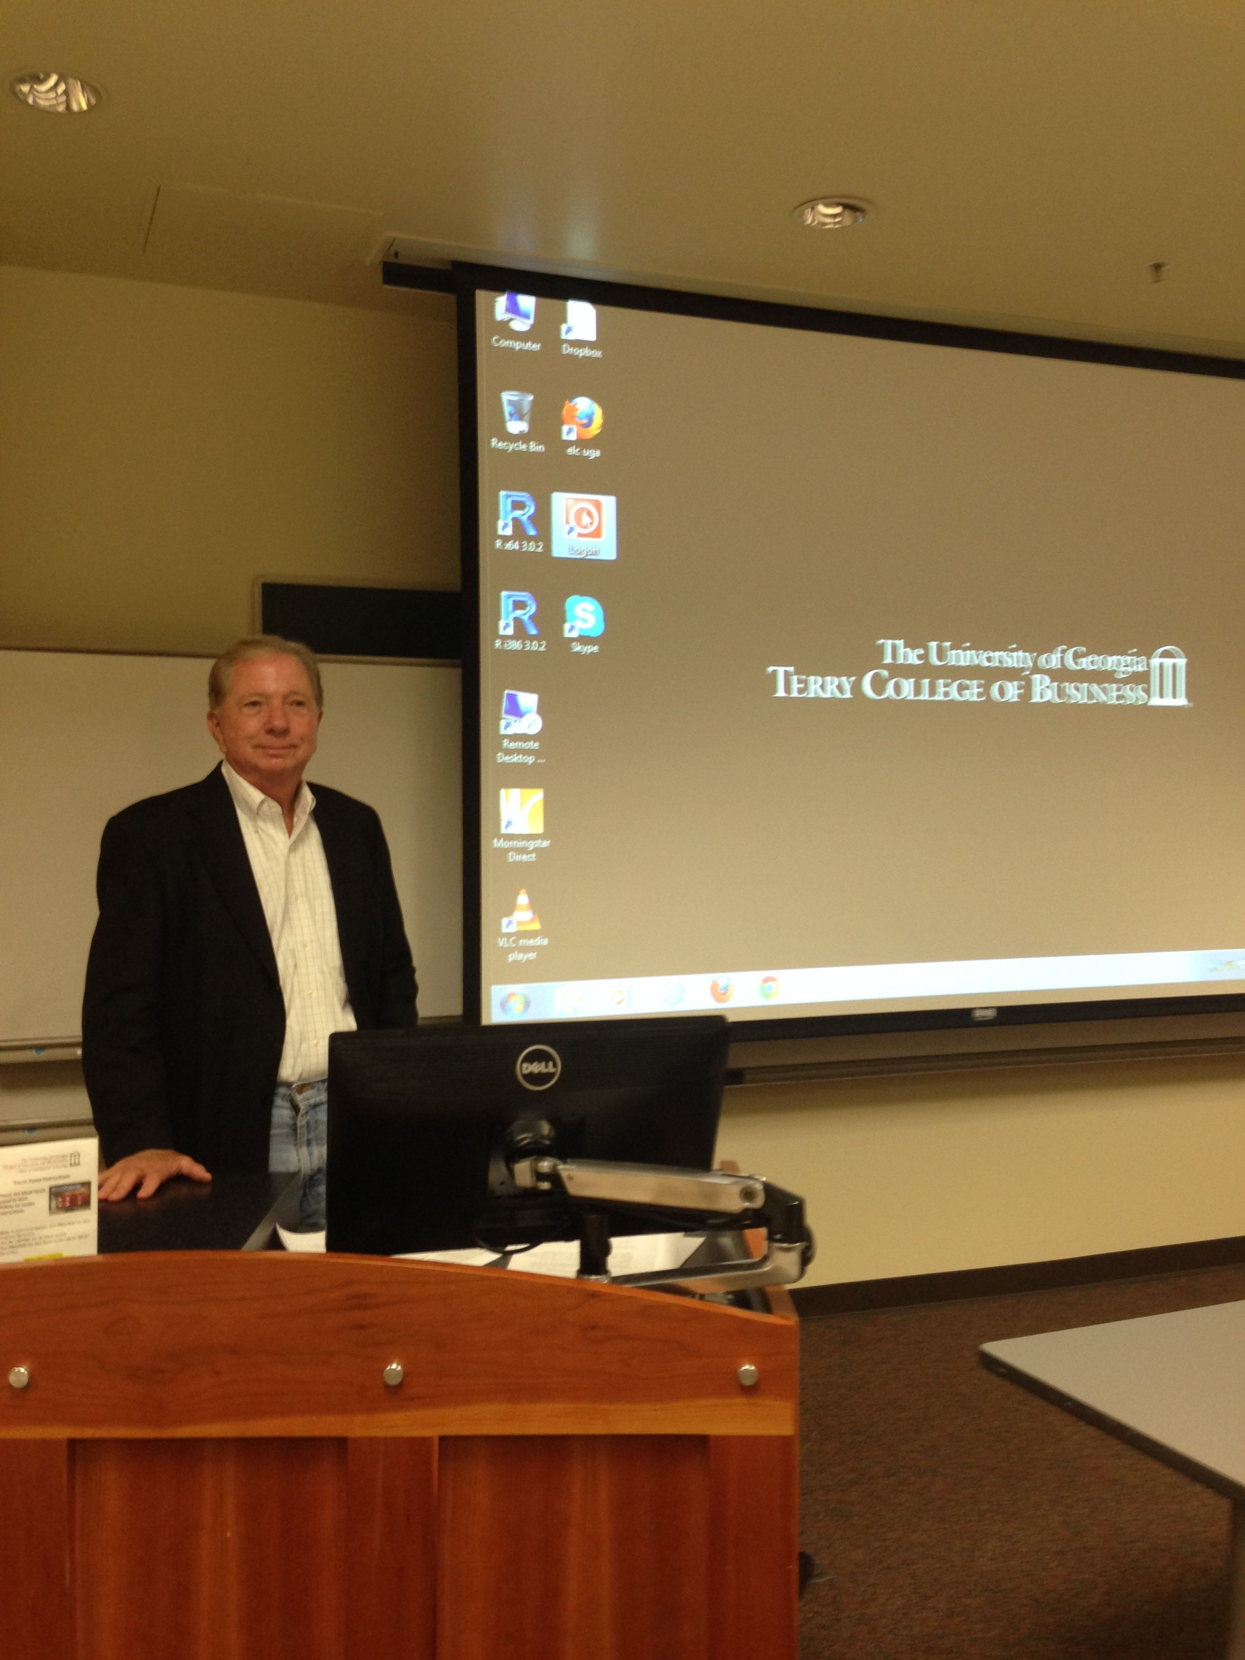



Some of the Things I Like

Slide 4
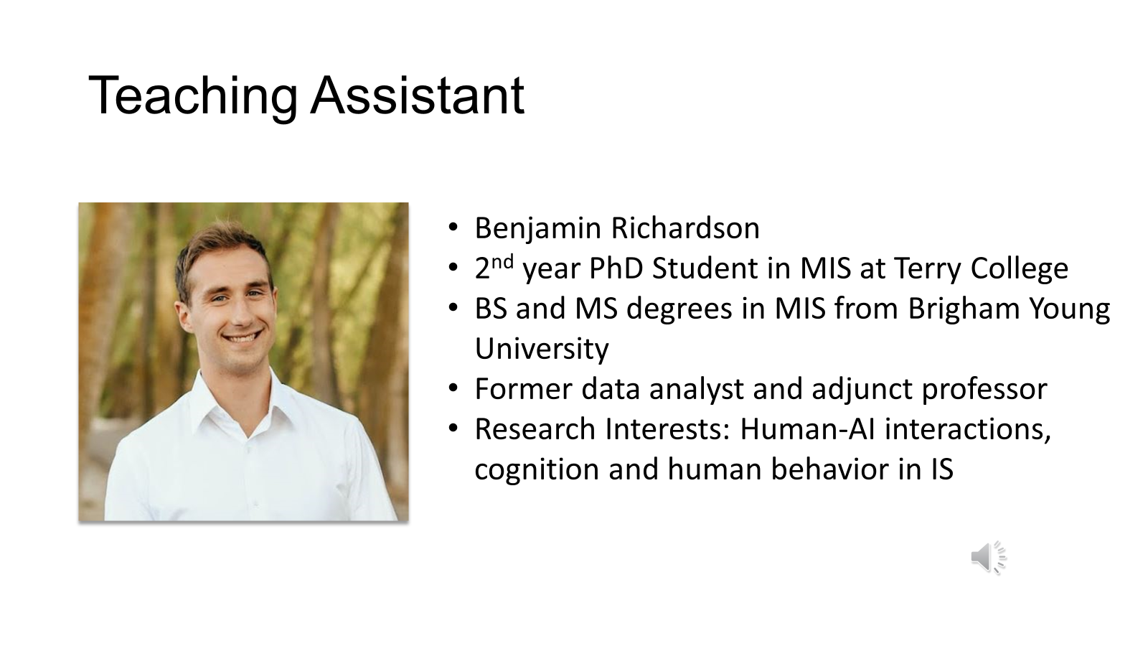

Slide 5

Teaching Assistant
Jason Qu
2^{ed} year PhD Student in MIS at Terry College
Bachelor’s degree in Accounting from University of Alabama
Master’s degree in MIS from Georgia Washington University
Full Stack Engineer in HSBC
Program Analyst in the Federal Department of Transportation
Data Analyst at ConnectYourCare(Optum)
Research Interests: Platform Ecosystem

Slide 6
Course Objectives
To become familiar with data science/business analytics
To learn the various kinds of analytics
To understand connecting the business and data science strategies
To learn the business uses and value of data science
To learn the developmental methodologies for data science
To experience hands-on data science predictive modeling

Slide 7
More Course Objectives
To learn about the required data science infrastructure
To learn about the various data science software alternatives
To learn the use and development of AI applications
To learn the legal and ethical issues associated with data science
To learn career opportunities in data science
To be a savvy entrant into the data science workplace

Slide 8


Primary Course Objective: Don’t Be This Guy When You Go To Work
Really?
I didn’t know that
I’m supposed to do that?
WTF?
You mean, I’m supposed to create business value?
Is this what data scientists really do?

Slide 9
Course Organization in eLC

Slide 10
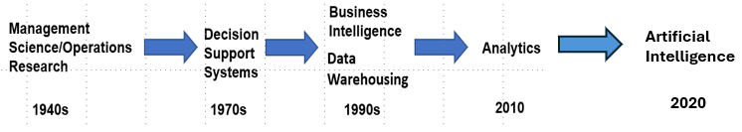
Data Science History

Slide 11
The Analytics Application “Stack”
SQL
Reports
Decision Support Systems
Executive Information Systems
Analytics Portals
Data Visualization
Dashboards/Scorecards
Predictive Models/Data Mining
Machine Learning
Simulation
Mathematical Programming
Artificial Intelligence

Slide 12
Data science is an interdisciplinary field of scientific methods, processes, algorithms, and systems to extract knowledge or insights from data in various forms, either structured or unstructured.
Wikipedia
Notes:
Success with data science requires more than algorithms.

Slide 13
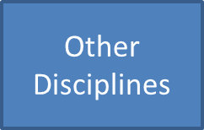
Data Science Is Multidisciplinary
Database
Statistics
Software
Engineering
Machine
Learning
Data Science
Visualization
Artificial
Intelligence
Computer
Science
Notes:
Business schools like Terry offer courses, concentrations, and degrees in data science (we call it business analytics), but similar opportunities exist across campus. Any discipline that has lots of data that needs to be analyzed is likely to be involved in data science.

Slide 14
In Business Schools, Data Science Is Often Referred to as Business Analytics

Slide 15
Transactional (or Operational) Systems Are Different from Analytics
Though there are overlaps

Slide 16
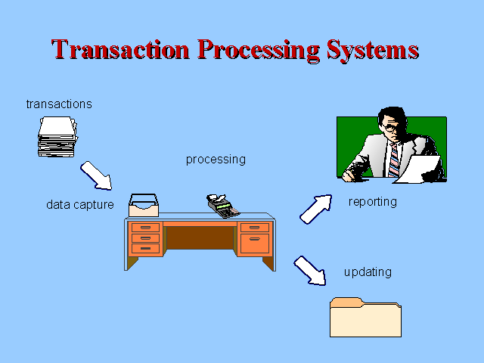
Transactional Systems
Electronically record business transactions
Examples include order entry, inventory control, invoicing, and payroll
Provide limited support for decision making – summaries of the transactions that have taken place

Slide 17
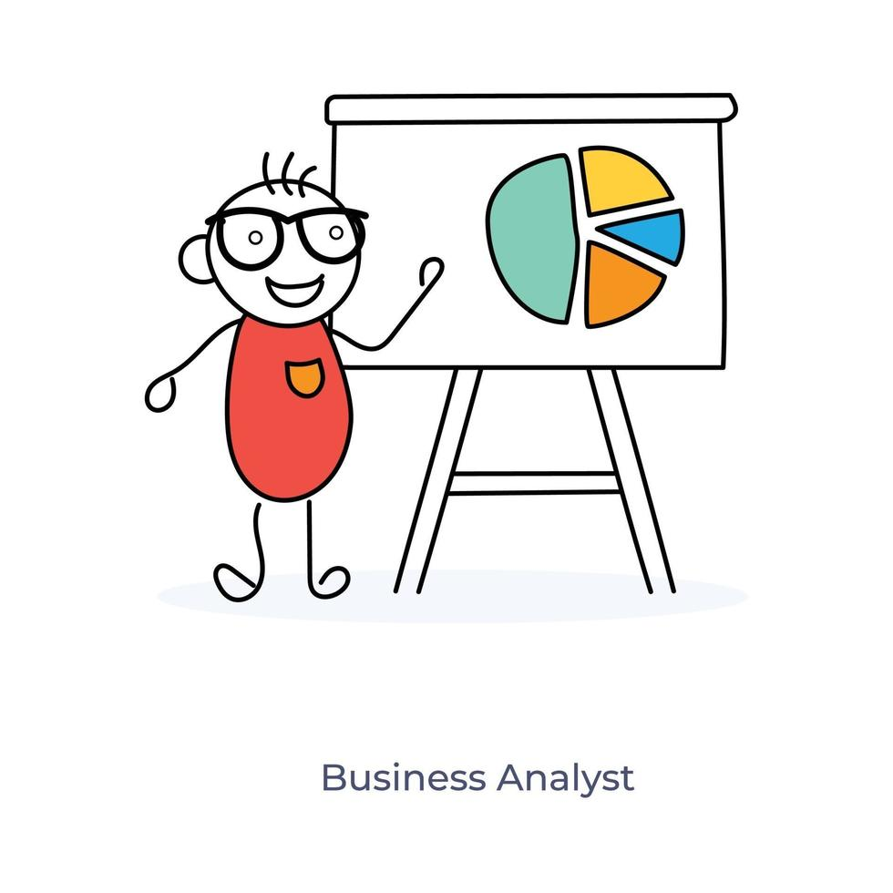
Analytics
Provides support for decision making and improving organizational performance
Examples include dashboards, customer segmentation analysis, and supply chain optimization

Slide 18
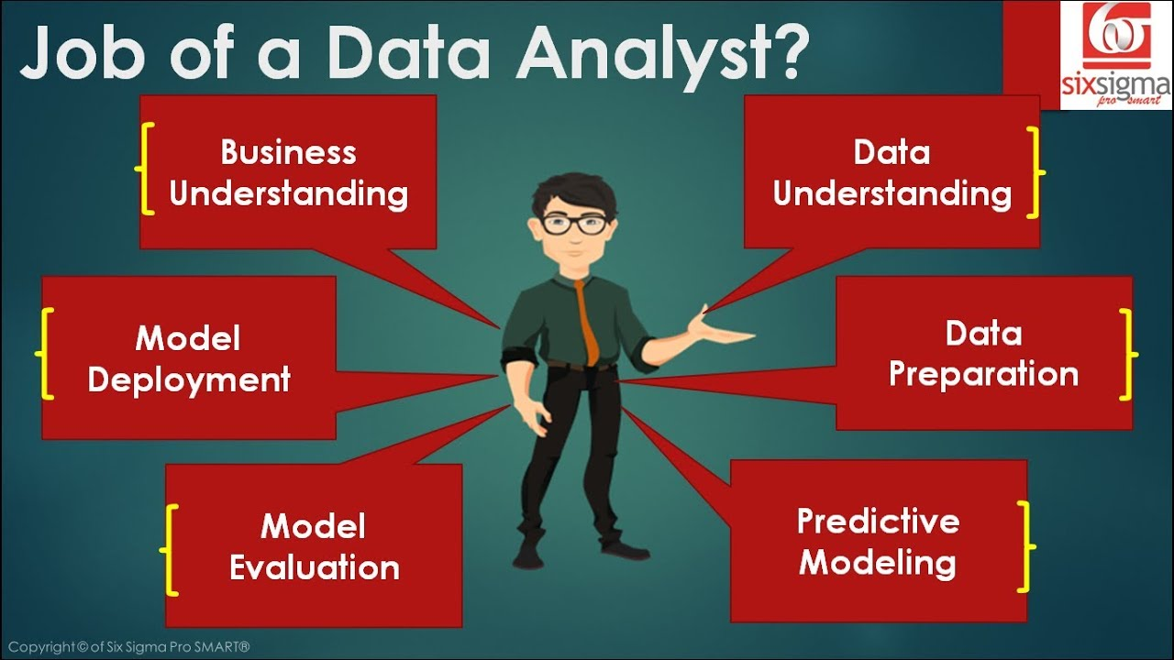
Building Models and Systems Are Different
Models are just that – models
Models need to be integrated into applications and systems
Systems need data pipelines, data cleansing and transformation, models, coding, implementation, monitoring, and updating

Slide 19
What Are Your Experiences with Business Analytics?

Slide 20


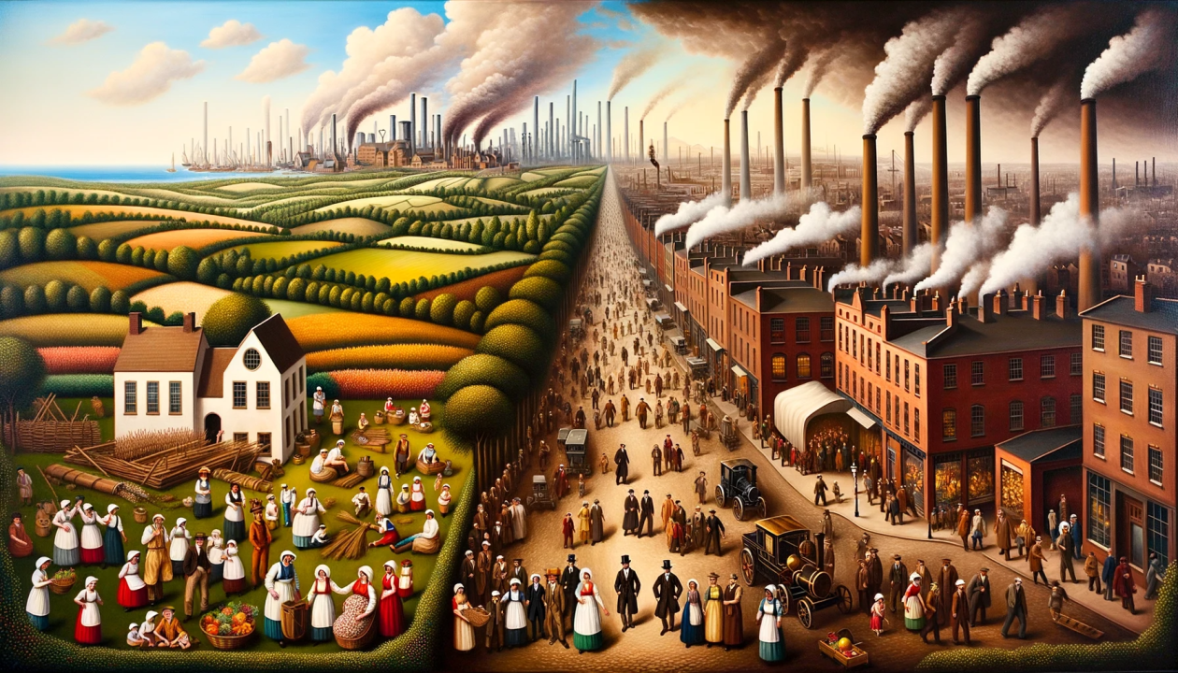
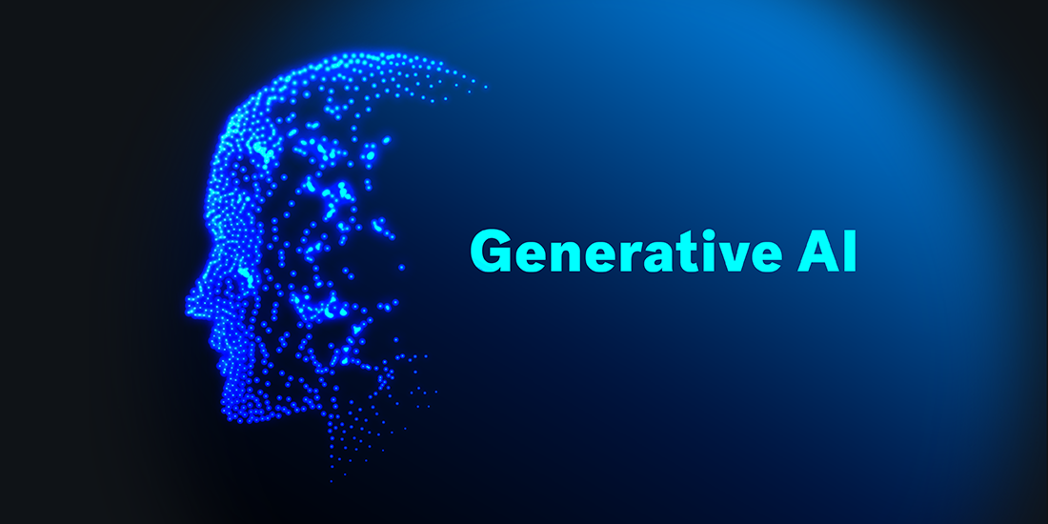

Transformational Technologies
Fire
Electricity
Industrial Revolution
Does Generative AI Belong?
Internet
Generative AI

Slide 21

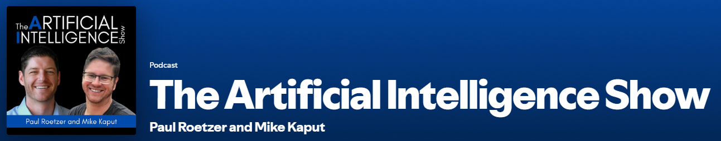
My Favorite AI Podcasts (Spotify)
15 minutes long
An hour long

